Slide 1
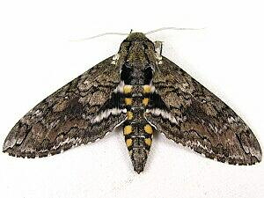
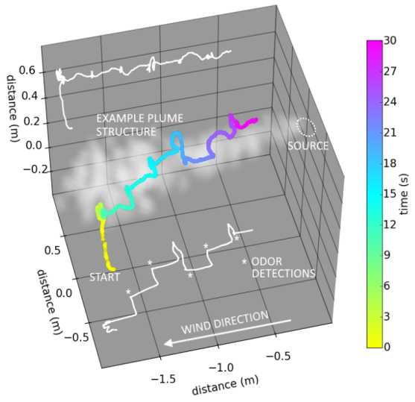
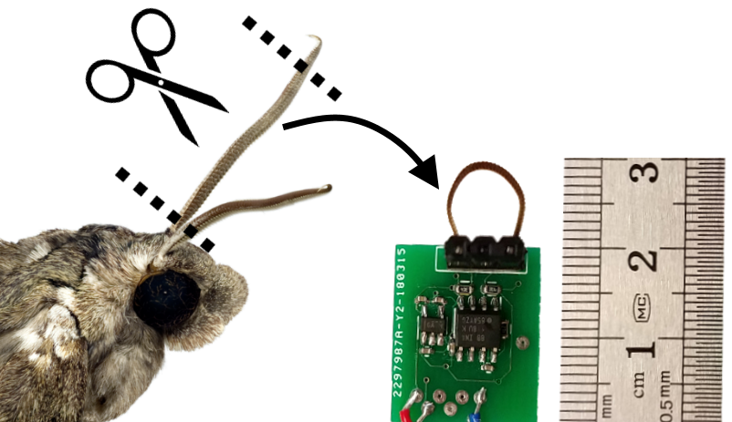
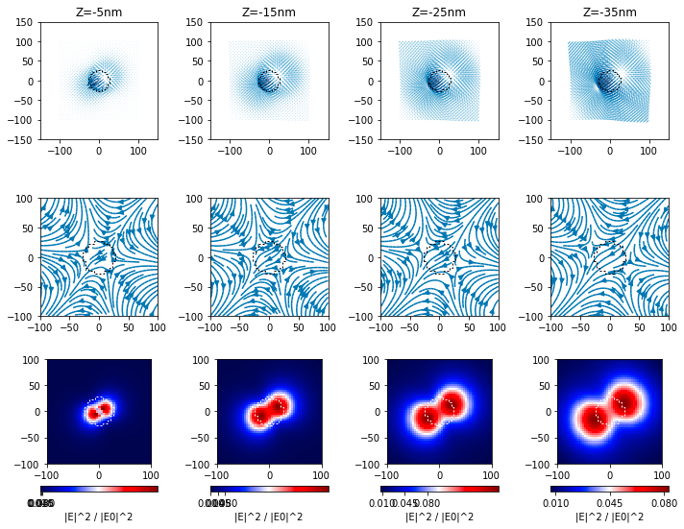
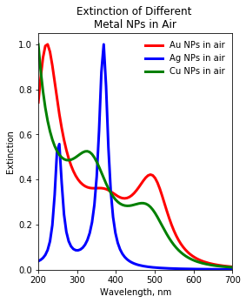
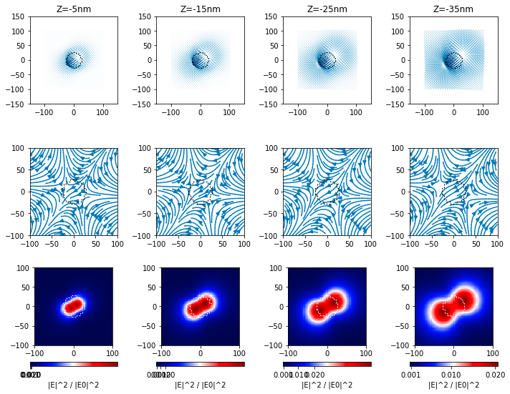
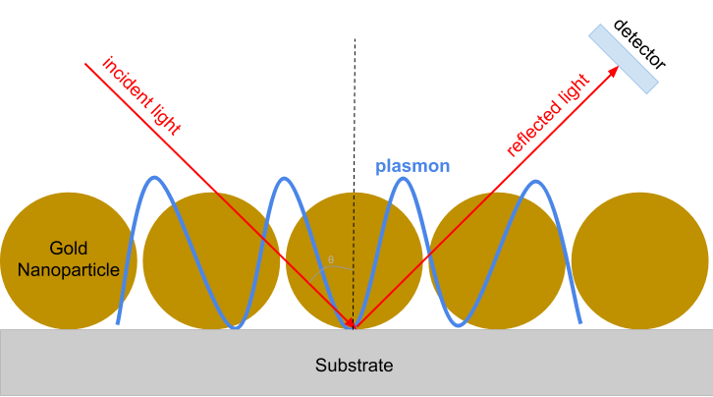
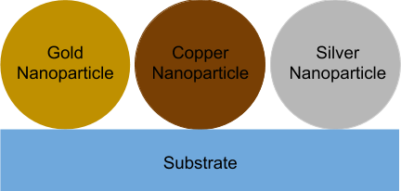
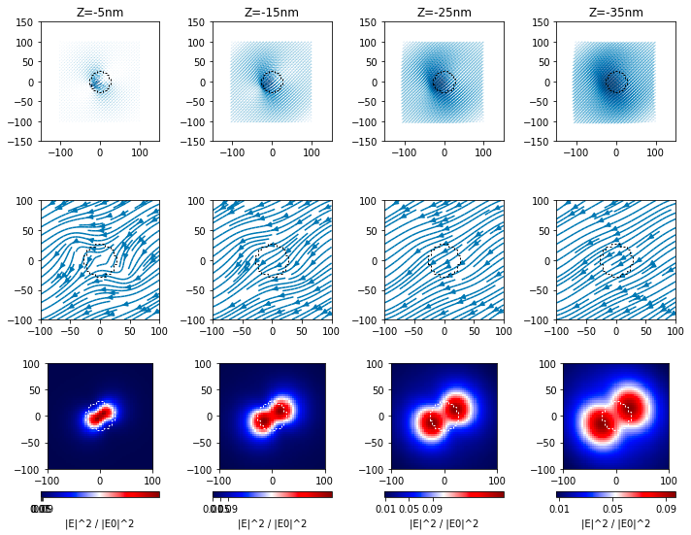
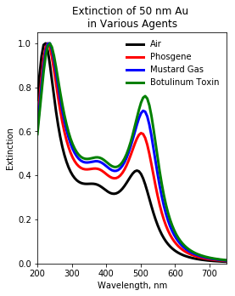
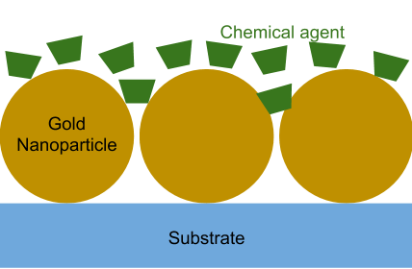
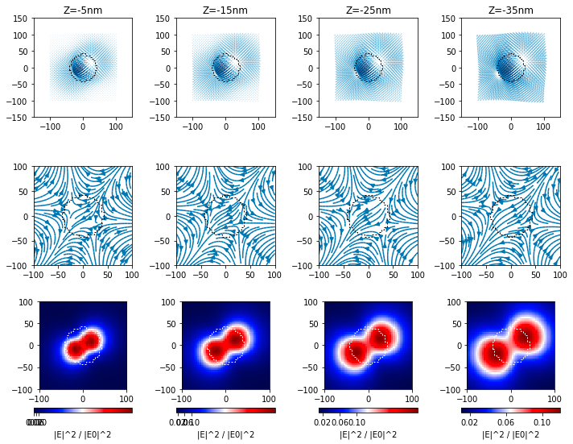
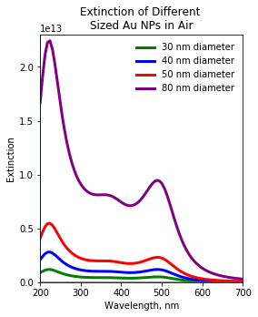
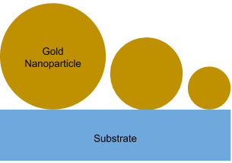
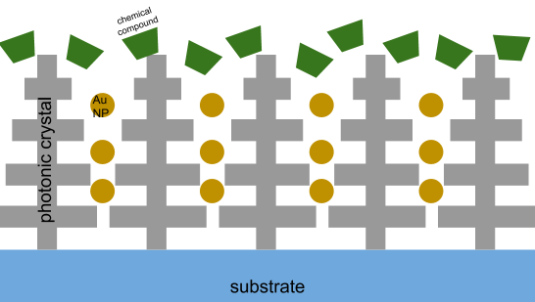
Design of Plasmonic Chemical Sensor
Christine Zou
Background
In order to detect chemical and biological agents, currently technologies require a person to use a handheld device to approach the unknown agent, putting the safety of the person at risk. In order to solve this problem, chemical sensors that can be attached onto any unmanned vehicle have been proposed.
Notably, the “Smellicopter” designed in 2018, was able to detect and follow a moth’s chemical plume by using a a moth’s antenna as a chemical sensor. However, this approach had a short shelf life and was limited to only detecting specific moth hormones. Thus, additional research is being conducted in order to avoid these limitations.
The “Smellicopter.”¹
Model and Simulation
(a)
(b)
Surface Plasmons
(c)
50nm Ag NP in air, wavelength = 410nm
²50nm Au NP in air, wavelength = 550nm (a)electric field vectors (b)electric potential isolines (c)field intensity
Surface plasmon resonances (SPRs) occur typically when light causes the free electrons in roughened (or nanoscale) noble metal surfaces to oscillate coherently. These oscillations give rise to a strong electric field which interacts very strongly with light at those frequencies. SPRs are very sensitive to changes in the surrounding environment.
A single molecule in the vicinity of a SPR can cause an observable change in the SPR frequency. This arises from the change in dielectric environment. Although silver nanoparticles (NPs) have the sharpest SPR peak, it is highly prone to oxidation. Gold NPs are our most promising option due to their robust nature.
NPs with larger radii has been shown to be more sensitive to the environment than smaller ones. We aim to use the highly sensitive SPRs of metal NPs to detect a variety of chemical agents.
50nm Au NP in Botulinum,
wavelength = 550nm
80nm Au NP in air, wavelength = 550nm
Future Direction
Photonic crystals found in the Morpho didius butterfly’s wings have also shown a high sensitivity to the detection of chemical agents. We aim to use both of these phenomena to generate a hybrid chemical/biological sensor.
The sensor will first be modeled in COMSOL and simulations will be run using Python to optimize the design prior to fabrication of the device.
Proposed Model of Sensor
¹Anderson, Melanie, et al. “The ”Smellicopter,” a bio-hybrid odor localizing nano air vehicle” AFRL Internal Technical Review Document, August 2018.
²Peter R. Wiecha,pyGDM – A python toolkit for full-field electro-dynamical simulations andevolutionary optimization of nanostructures, Computer Physics Communications233(2018),167–192.
Distribution A: Distribution Unlimited pending Public Release

